Slide 1
February 2022
Category review: Chips
Retail Analytics
Brand note: If client logo is not required, use alternate title page layout right click slide thumbnail > Layout > Title

Slide 2
Notes:
To view Privacy video explaining how important data privacy is to Quantium, please click here: https://www.youtube.com/watch?v=Zq1QDAkoRzU
or here Q:\Company Reference\Brand & Design\Brand videos\Q Privacy.mp4
At Quantium, we believe that data is the behavioural footprint of humanity and that it has to be treated with the utmost care and responsibility.
Histories, attitudes, indeed lives are stored within it in ways that aren’t always apparent – and that’s what makes its potential so powerful.
To work with it responsibly, sensitively, we set ourselves the highest data privacy protection and governance standards.
We have spent 17 years perfecting privacy-by-design and secure-by-design principles. Central to this is not holding any personally identifiable information about people –
we neither receive it, and put the necessary protections in place to be unable to decipher it.
Every aspect of handling data is safeguarded: from its de-identification, to its encryption – data security is paramount and of the highest grade.
We pride ourselves on gaining the trust of iconic organisations around the world through years of securely working with their data,
and in turn the trust that builds with their stakeholders.
<number>

Slide 3
Executive summary
01
The Chips brand 'Kettle' offers the highest total number of sales across all stores.
Store number 226 is the store with most total sales.
For the year under review transactions took place for 364 days, out of 365 days. The only day with no transaction is December 25th which happens to be Christmas day. So , probably all stores were closed on that day.
A day to Christmas, December 24th, accounts for the most sales in a single day.
For the year under review, there were three significant changes in total sales, the month of August 2018 and May 2019 accounts for significant decline in total sales, while the month of December sees a significant increase in total sales.
In the Month of December the brand 'Kettle' accounts for most sales
175gram pack size of chips is the most Purchased
Mainstream Young singles/couples is the Customer segment with the highest number of customers
Budget Older Families tops the list in the highest number of total sales and total transactions
The most expensive product on our dataset is the 'Doritos Corn Chip Supreme', and the Mainstream Young Singles/Couples made the highest number of Purchases for this product.
Task 1
02
The control store for trial store 77 is store 233
The control store for trial store 86 is store 155
The control store for trial store 88 is store 237
The trial period experienced a significant increased in total sales in at least two months of the three trial months across all trial stores..
In trial store 86, there was an increase in all three months of the trial period in terms of number of customers., But this didn't directly translate into a much higher total sales within this period.
Trial store 88 shows a significant increase in total sales in the final two months of the trial period, but this was mainly influenced by the average number of transaction per customer and not the total number of customers.
Task 2

Slide 4
01
Category

Slide 5
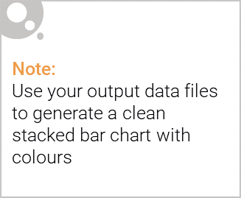
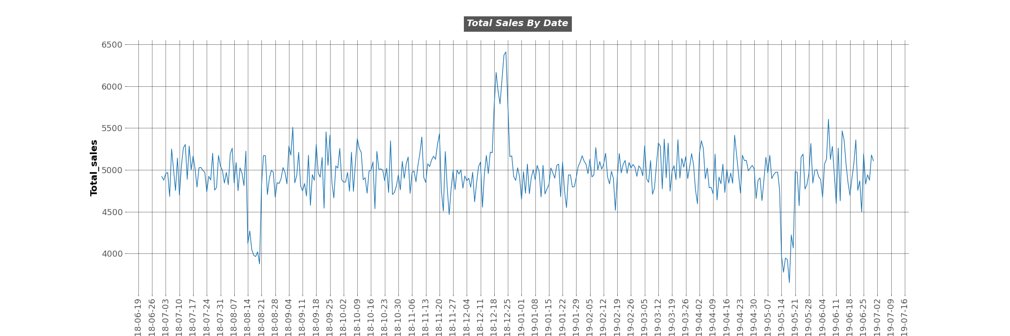
Editable (delete this)
Through the year under review we can easily deduce significant changes in the total sales during three distinct period
The month of August 2018 and May 2019 accounts for a sharp decline in the total sales of chips
December 2018, also saw a significant increase in the total sales of chips

Slide 6
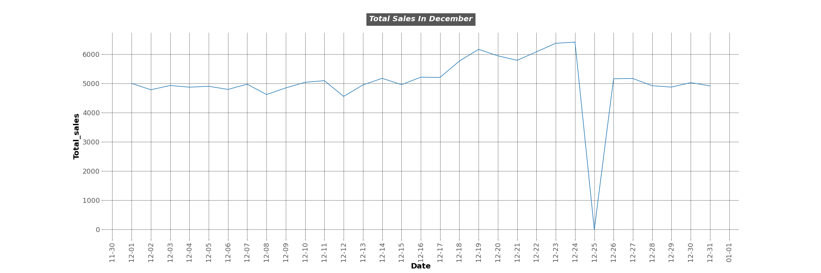
Editable (delete this)
The month of December saw the increase of sales.
The 25th of December, which is Christmas day had zero sales. This is because all the retail stores were closed on that day.
The 24th of December 2018 accounts for the most sales in a single day for the year under review.

Slide 7
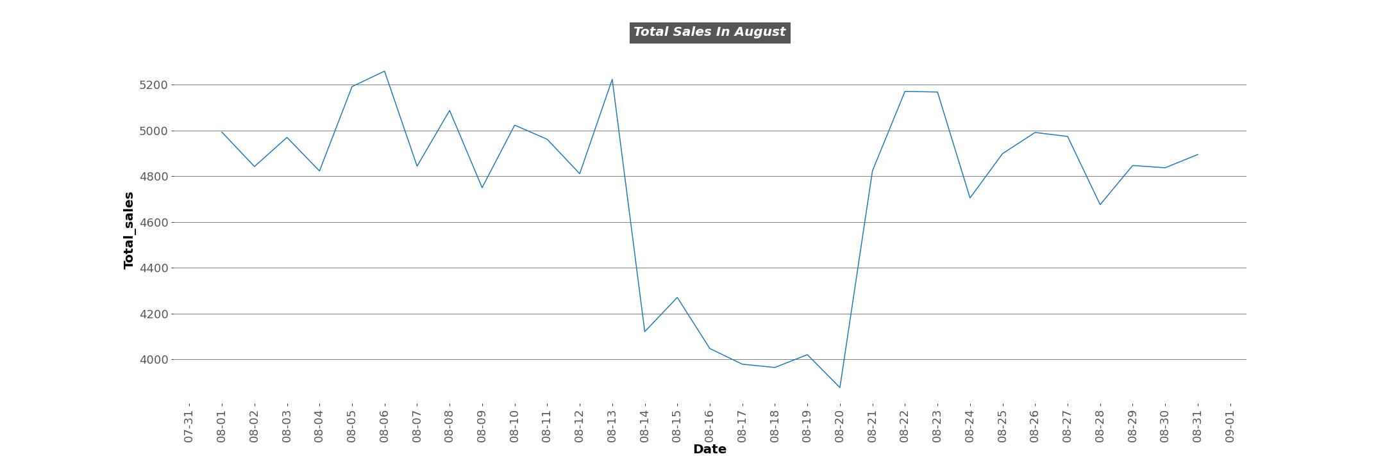
Editable (delete this)
The month of August records a drop in sales
From the 14th of the month through to the 20th there was a steady decline in sales.

Slide 8
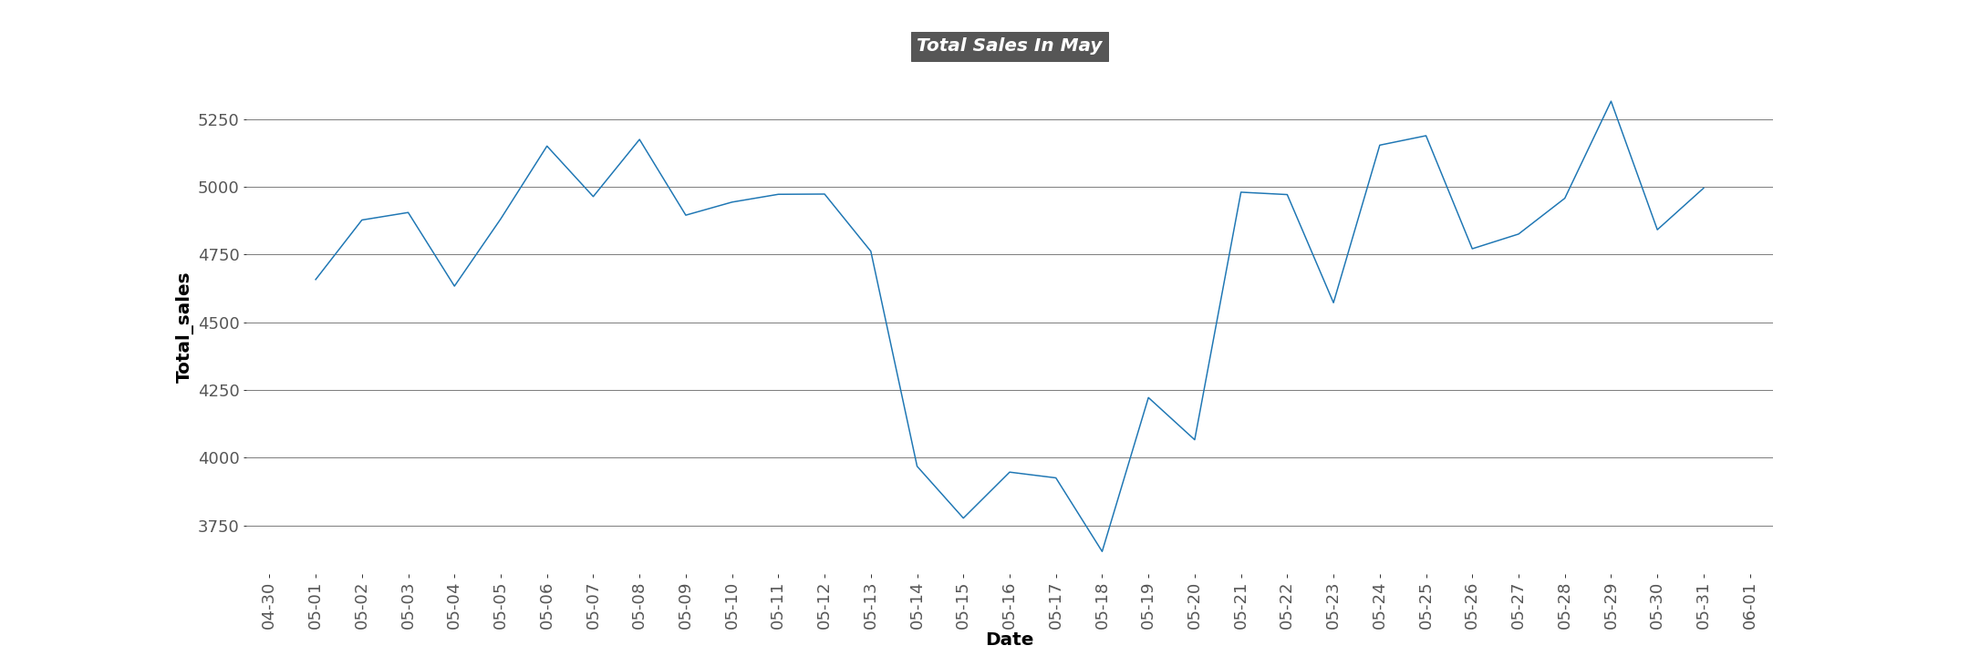
Editable (delete this)
The month of May 2019, there was a major drop in sales
From the 14th-18th there was a major drop in the total sales of chips from the stores

Slide 9
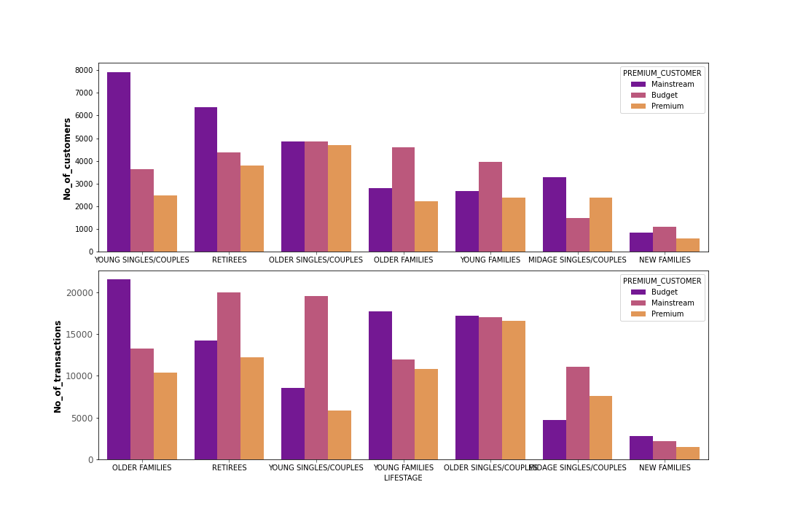
Editable (delete this)
The above Visualization helps in comparing how the number of customers influenced the number of transactions made for the year.
The Mainstream Young Singles/Couples have more customers in terms of our customer segment
But we can see that the Budget Older Families made more transactions for the year under review. So the Mainstream Young singles/Couples have more customers but they didn't purchase the highest number of chips.
The Mainstream Young Singles/Couples comes third in the order of customer segment with more transactions, despite topping the list of segment with most customers

Slide 10
02
Trial store performance

Slide 11
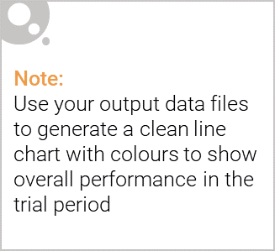
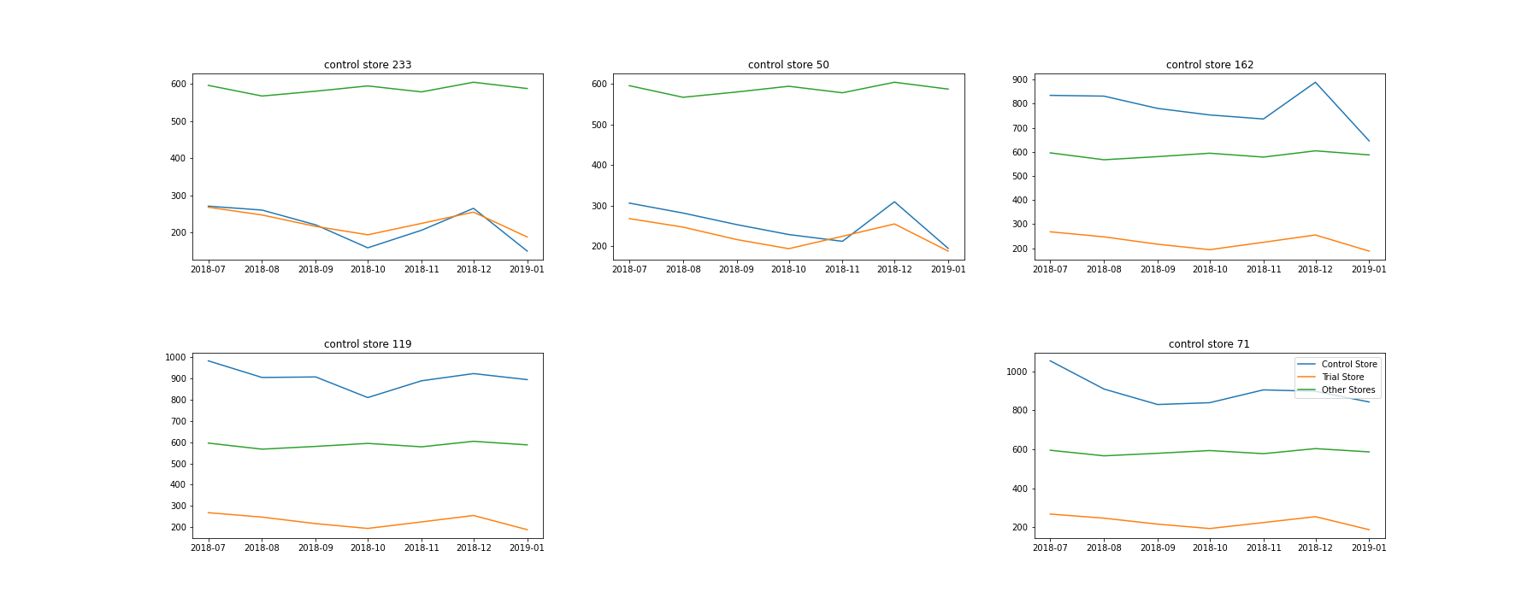
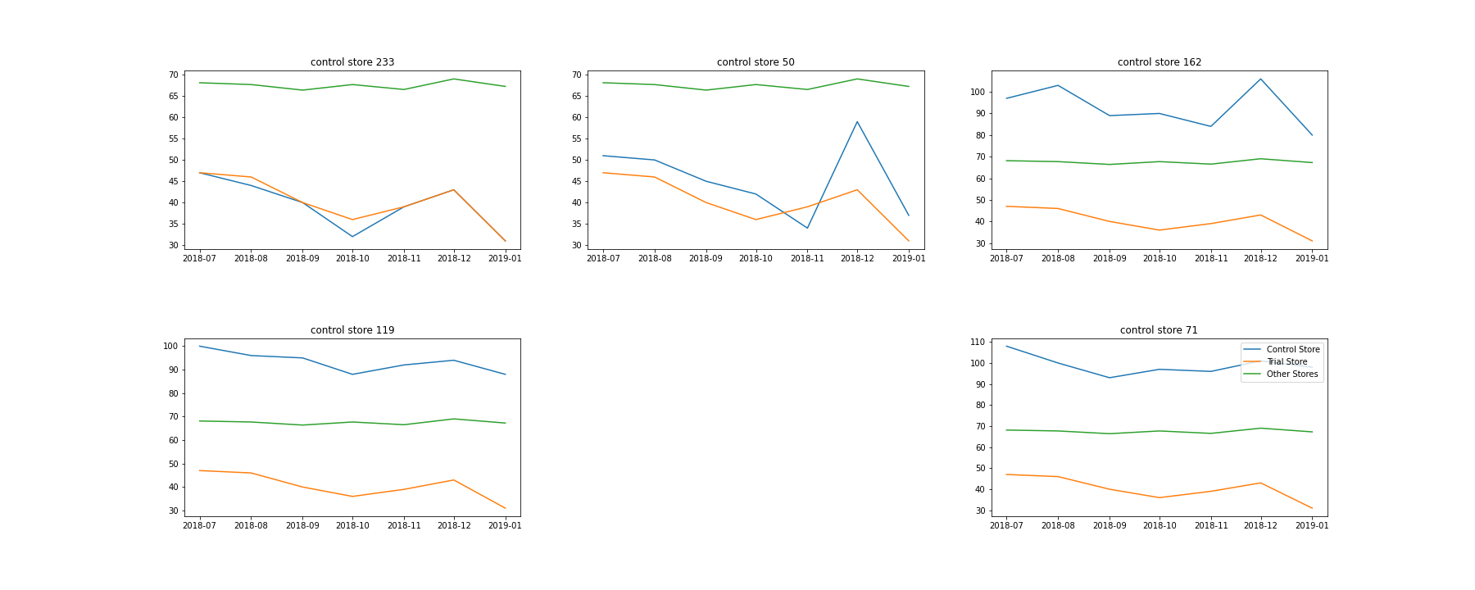
Explanation of the control store vs other stores
Trial Store: 77
Control sore: 233
Total sales trial store vs control store and other stores
Customer trial store vs control store and other stores

Slide 12
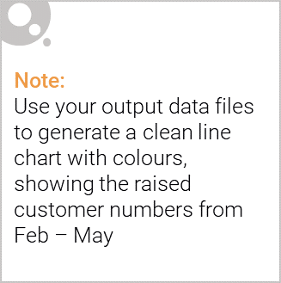
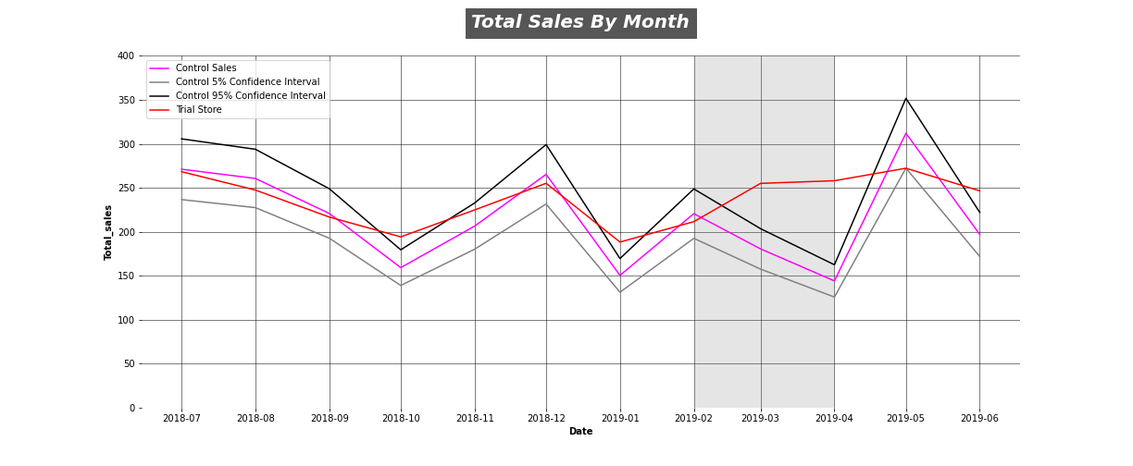
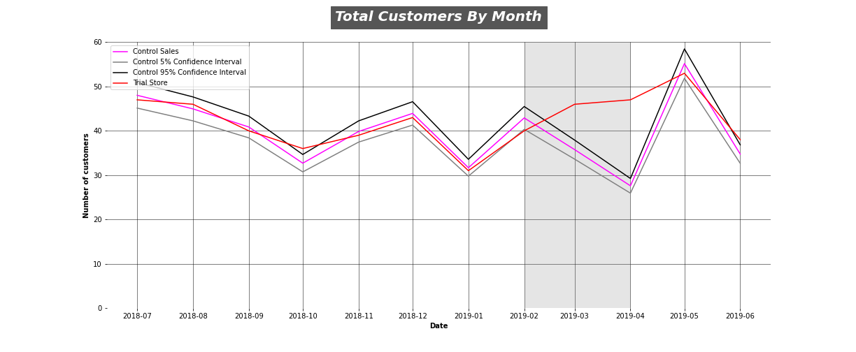
Assessment Of Performance for Trial Store 77
The result for the trial store 77 during the three months trial period, witnessed a significant increase in the final two months of the trial period.
The trial period which starts from February didn't see much increase in total sales and customers.
But the month of March and April saw a significant change in the increase of total sales and customers.
With this we can say the trial period with store 77 was successful.

Slide 13
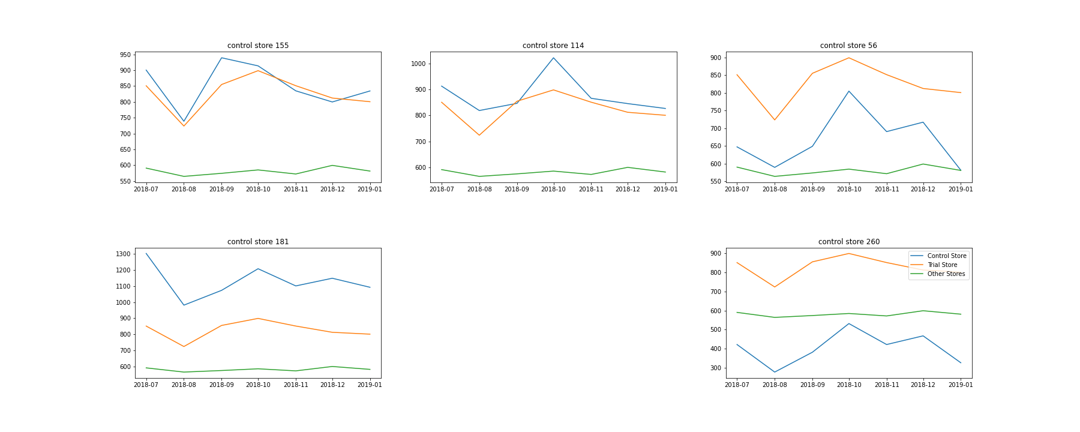
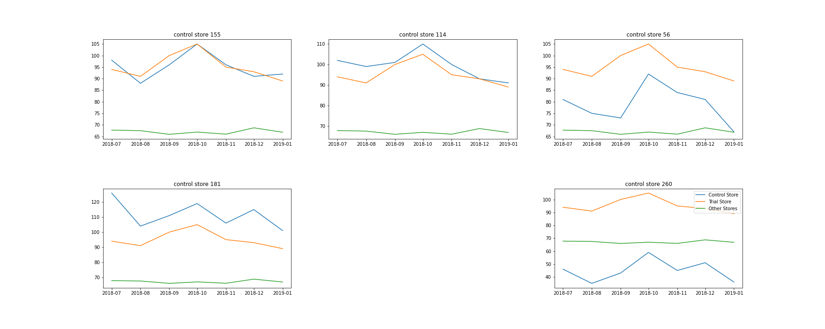
Explanation of the control store vs other stores
Trial Store: 86
Control sore: 155
Total sales trial store vs control store and other stores
Customer trial store vs control store and other stores

Slide 14
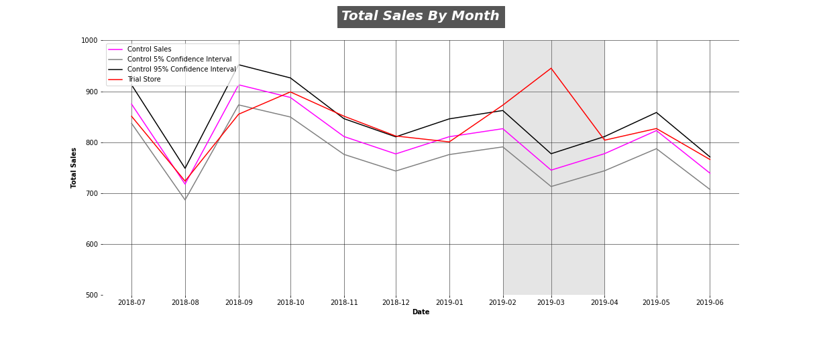
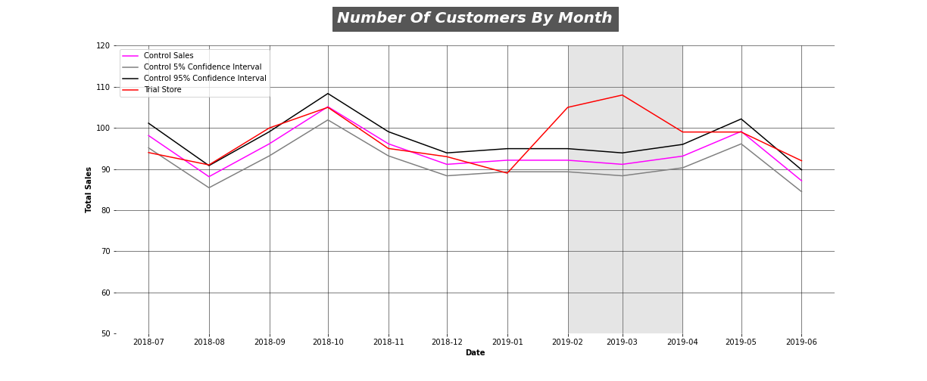
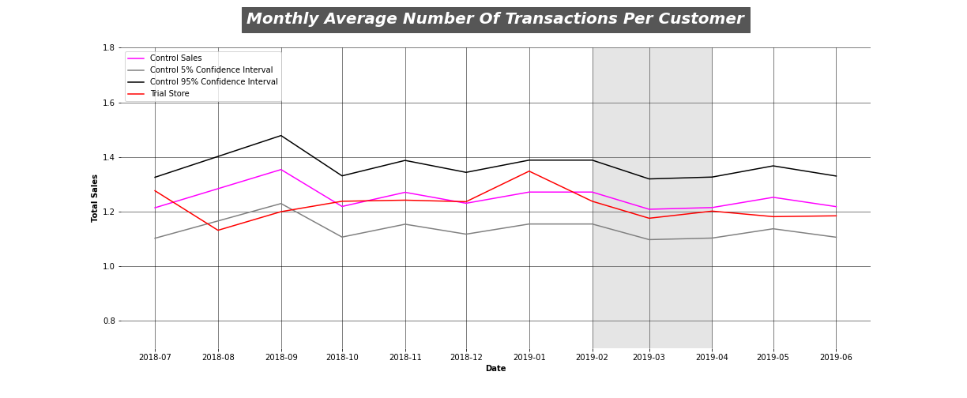
Assessment Of Performance for Trial Store 86
The first month of the trial period saw a significant increase in the total sales in our trial store when compared to our control store, as the trial store slightly edged out the 95% control interval.
From the first month through to the start of the second month, there occurs more increase in total sales.
The third month of the trial period shows a sharp decline in total sales and this results in the trial store falling below the 95% confidence interval.
The total number of customers in the trial period saw a massive increase, but this didn't really translate into a more significant increase in the total sales.
Even if the trial period saw more sales, but with the type of increase in customers during this period, there should have been more total sales than we experienced.
Looking further at the average number of transactions per customer, we can see how low it is, as it falls within the 5% and 95% confidence interval.
So, we can see that the increase in total sales was largely influenced not only by the increase in customers during the trial period but by also the low number of transactions made by these customers.

Slide 15
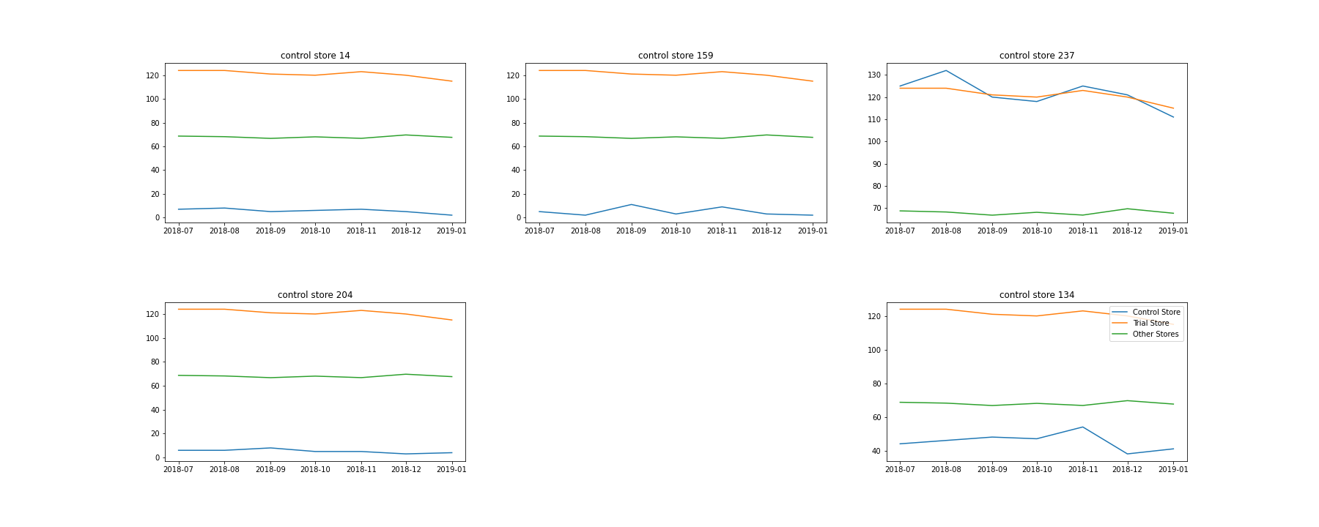
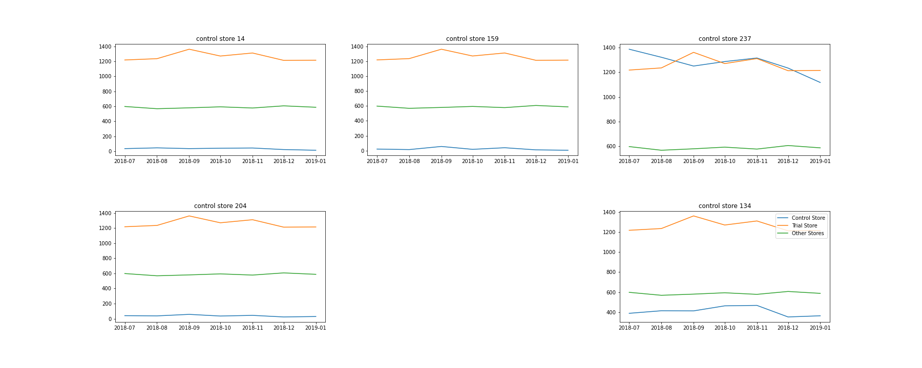
Explanation of the control store vs other stores
Total sales trial store vs control store and other stores
Customer trial store vs control store and other stores

Slide 16
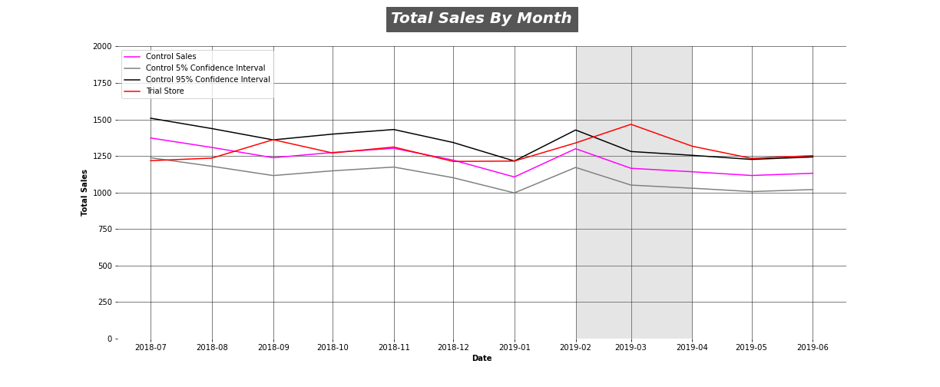
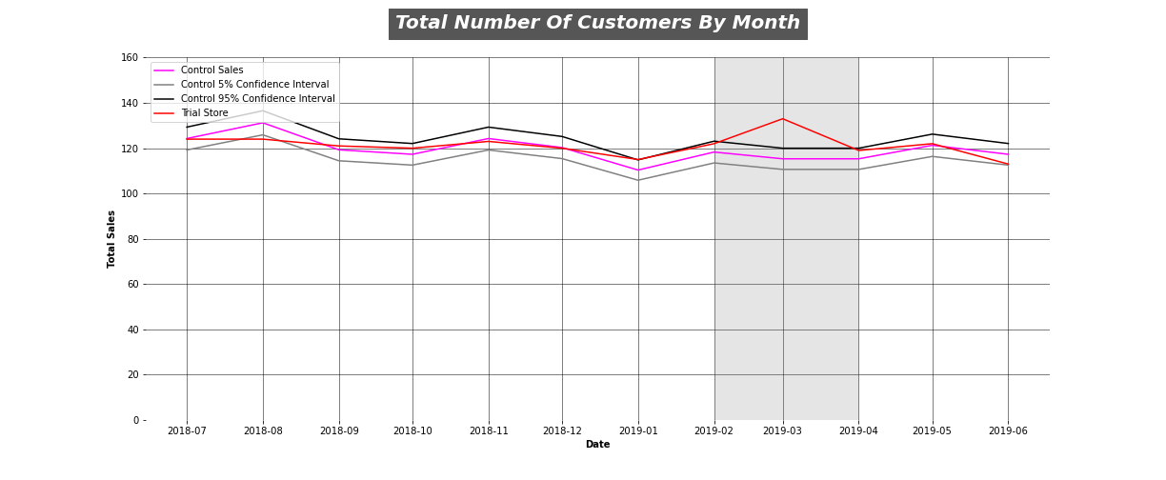
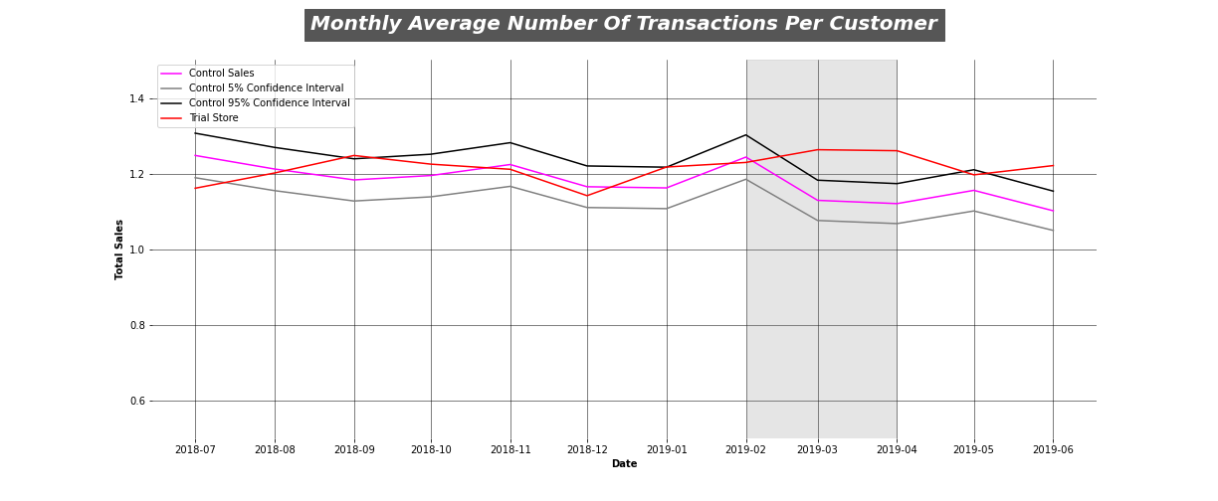
Assessment Of Performance for Trial Store 88
During the trial period there was a significant increase in total sales for the month of March and April.
The trial period is from the start of February to the end of April.
But the total customers didn't have similar significant change in the month of April.
We can deduce that the significant increase in total sales in the month of March was due to the increase of customers.
But the month of April saw a drop in the number of customers but there was still a significant change in the total sales, even if it was less than the previous month.
We can see further that the average number of transactions made by customers, had a positive impact in March and April.
So, even if there was a diminish in the number of customers from March in the month of April, this didn't really affect our total sales much, as the average number of transactions for the month of March and April saw a significant change.
And this played a major role in the trial period that saw an increase in the total sales in the final two trial months.

Slide 17
Notes:
<number>

